Slide 1
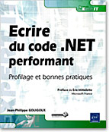
Five patterns for Green Programming
JP Gouigoux, MVP

Slide 2
Goals
Show most common smells
Explain why they are a pain
Provide a solution
How to detect them

Slide 3
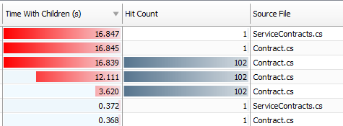
Correct use of loops
THE typical smell
Principle #1 : reduce number of iterations
Principle #2 : reduce content
Principle #3 : use cache effects
Pattern seen in a profiler :

Slide 4
Correct use of exceptions
1 exception ≈ 1000 boolean tests
Only use in exceptional cases, as the name indicates

Slide 5
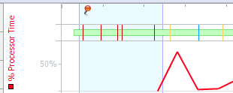
Correct use of exceptions
Any good profiler shows them
As much as possible, stay in situations where exceptions cannot happen

Slide 6
Fair use of memory
Master variables life cycle
Late creation / early release
GC generations ratio : 1 / 10 / 1000
Never call GC.Collect()
Understand memory leaks
Understand fragmentation

Slide 7
Choosing the right API
No secret : RTFM
Typical case : string concatenation
.NET criteria : 5 operations

Slide 8
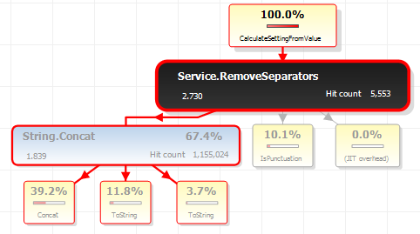
Choosing the right API
Hint : check for unbalanced distributions

Slide 9
Stream instead of load
StreamReader or StreamWriter instead of File.Read ou File.Append
XmlTextReader or XmlTextWriter instead of XmlDocument
Everything is great in Linq
Stream chaining
Lazy loading
Parallelism

Slide 10
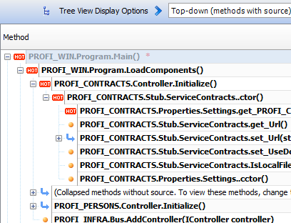
A few more recommendations
Use a profiler
Optimize hot paths first
Set a clear objective
Know your platform in depth
Do not confuse performance (speed) with performance (efficiency)

